Slide 1
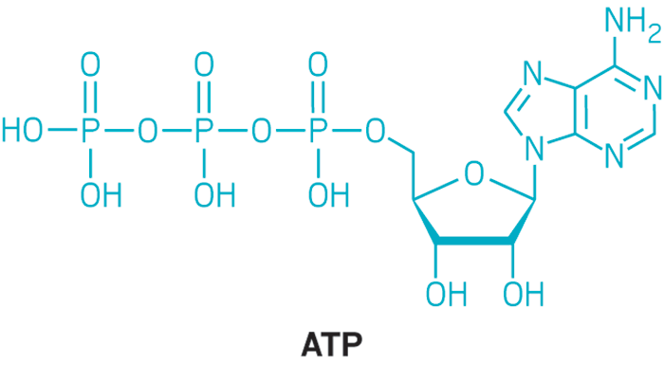
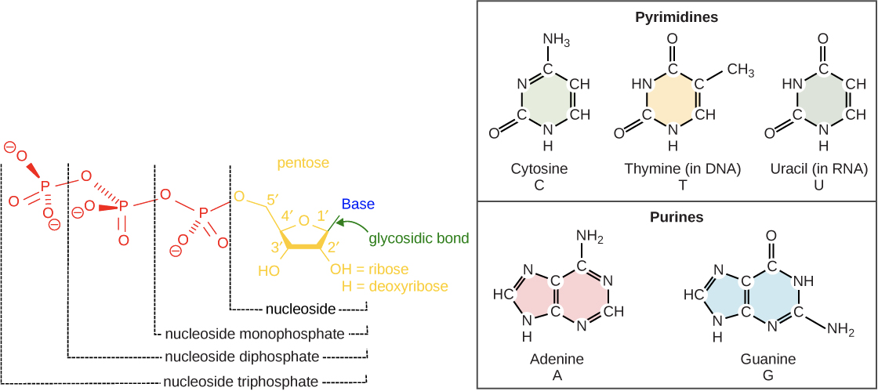

Slide 2
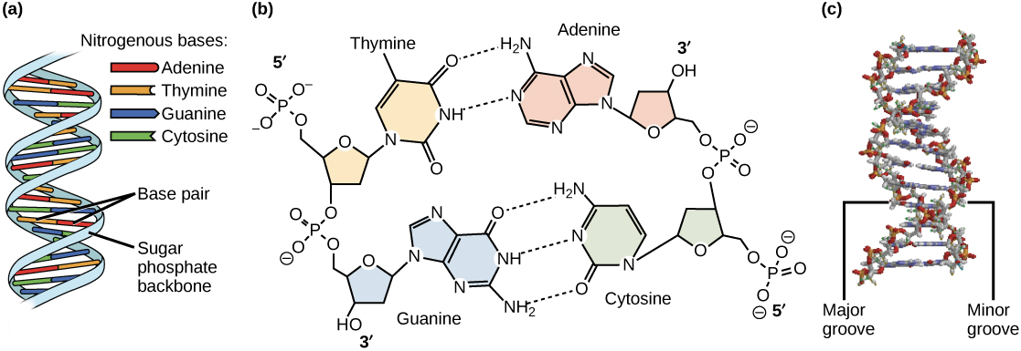

Slide 3
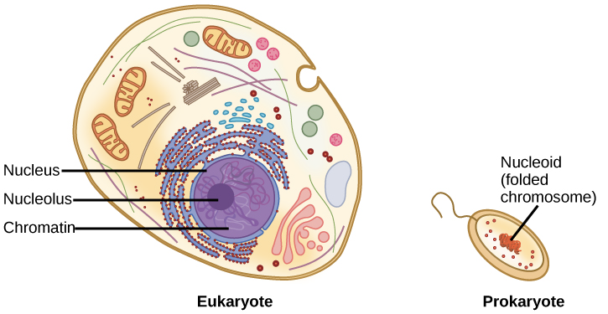

Slide 4
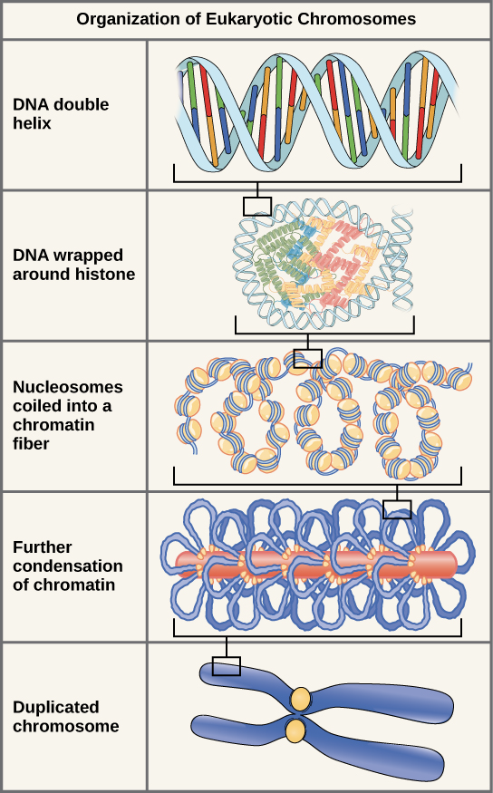

Slide 5
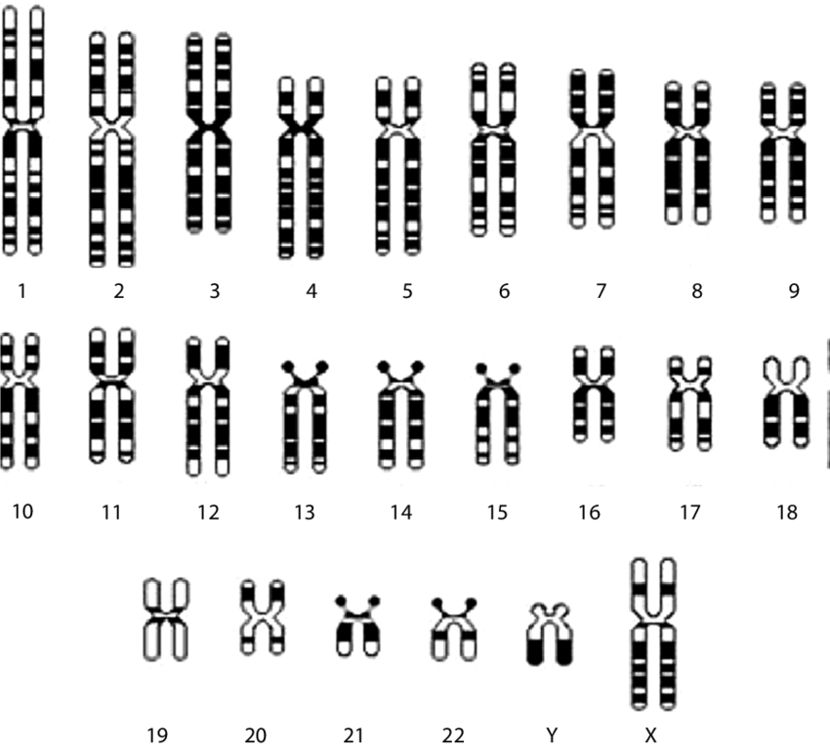
Karyotype

Slide 6
What is a genome?
All of the genetic information an organism has (each cell has a copy)
Mitochondria have their own genomes – you have a nuclear and a mitochondrial (mt) genome

Slide 7

Genome Size
Human – 3.2 billion
Mycoplasma – 580 thousand
Paris japonica – 149 billion
COVID-19 – 30 thousand

Slide 8
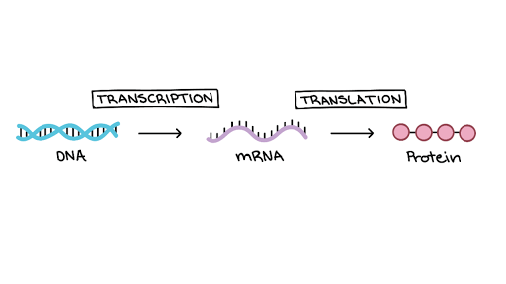
Flow of genetic information
The Central Dogma:
DNA is first transcribed into mRNA
mRNA strands are then translated into proteins

Slide 9
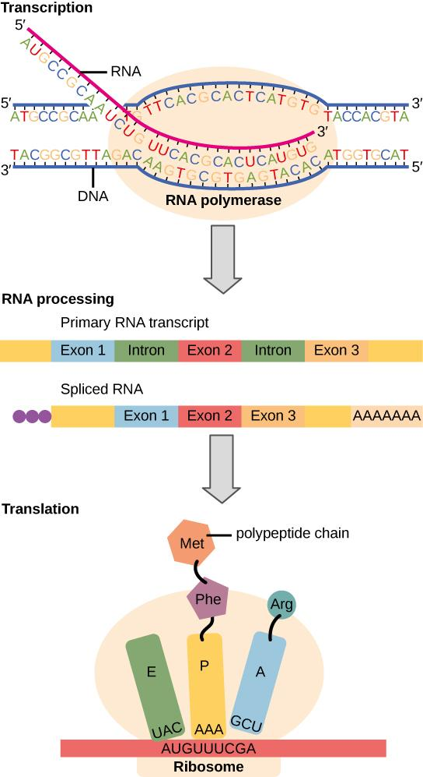
Flow of genetic information
Instructions on DNA are transcribed into messenger RNA.
Ribosomes are able to read the genetic information inscribed on a strand of messenger RNA.
They use this information to string amino acids together into a protein.

Slide 10
What is a transcriptome?
The complete set of transcribed sequences (e.g. mRNA) – the protein coding portion of the genome
When we “sequence a transcriptome” we are looking at a snapshot of genes that are being expressed at a particular point in time
taking a snapshot of what is going on in your organism/tissue/cell
RNAseq is the standard method for investigating transcriptome level changes in different experimental conditions

Slide 11
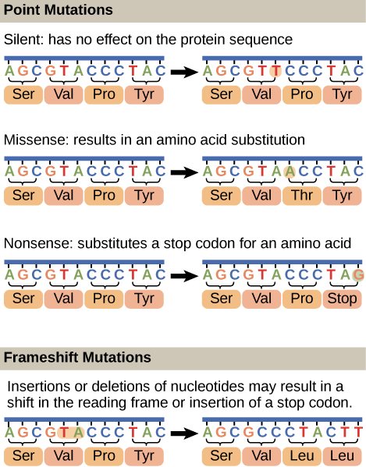

Slide 12
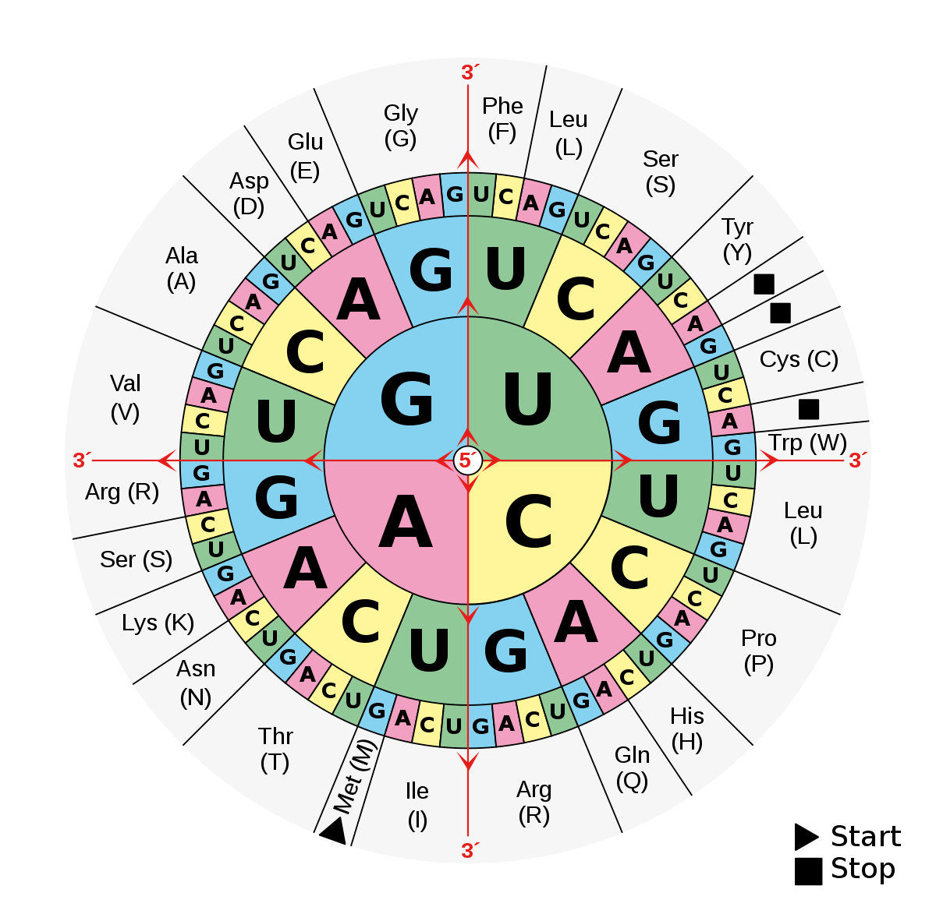
**Translation tables differ slightly between organisms and nuclear/mitochondrial**

Slide 13
Viruses – Quick facts
Non-cellular, protein coating with a nucleic acid center
Can have DNA or RNA genome
Codes for essential proteins and sometimes enzymes
Huge diversity of viruses – 10 nonillion (10^31)
Virus complexity does not reflect host complexity
Many different morphologies (”body” shapes)

Slide 14
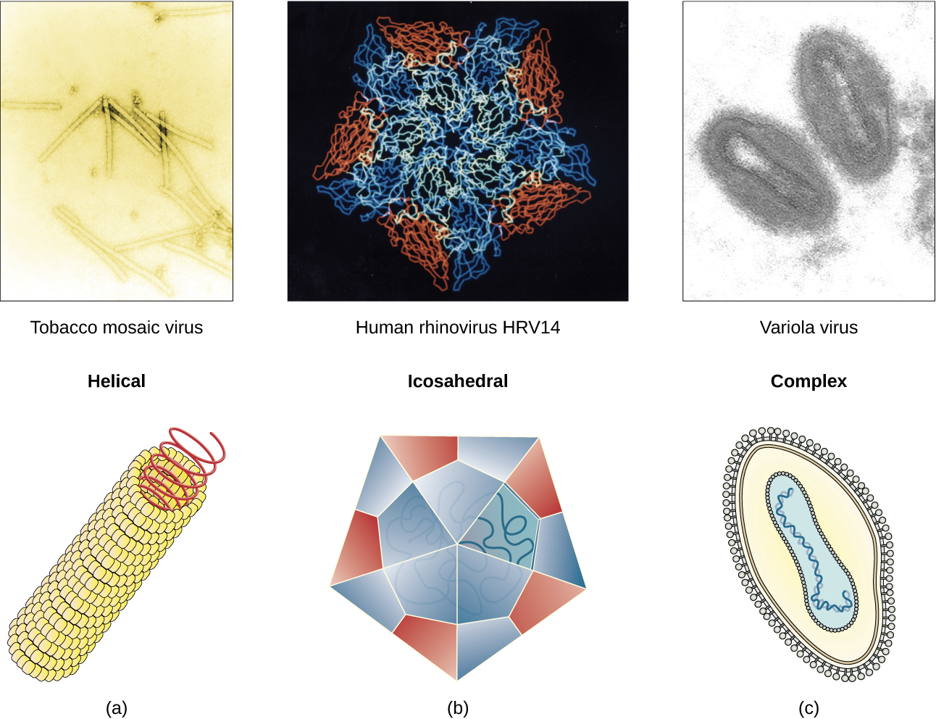

Slide 15
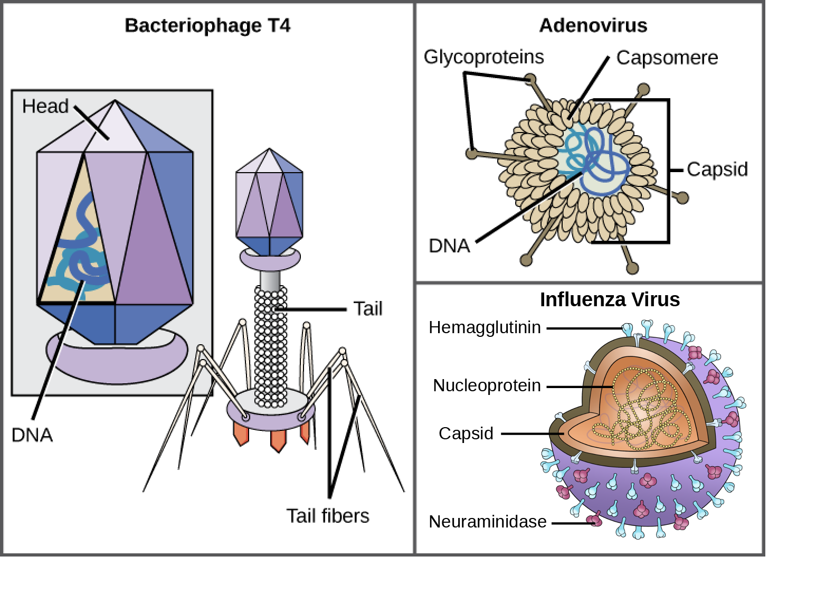

Slide 16
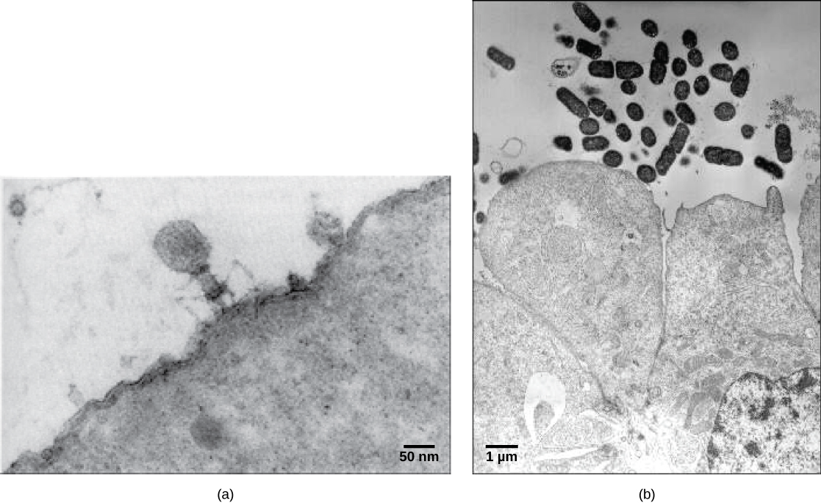
Head and Tail Morphology
Bacteria
Bacteriophage
Body Cell
Bacteria

Slide 17
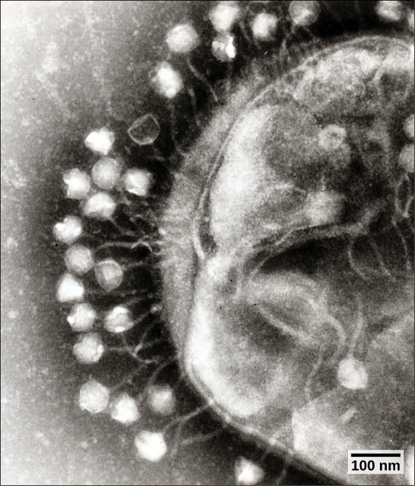

Slide 18
Biology for Bioinformatics?
Deep knowledge not strictly necessary to run analyses
May help guide analysis or lead to creative questions/solutions
Needed for interpretation and formal presentation of results
Often you will collaborate with someone who fills in the gaps

